Slide 1
Advanced Operations
Notes:
In this final class, we’re going to cover a hodge podge of different advanced issues that may help you in the kinds of NeoPixel projects you work on in the future. We will also dig a bit deeper into the nuts and bolts of how the NeoPixel system works in the hope of gaining a deeper understanding going forward.

Slide 2
Including Randomness
Notes:
Randomness in a NeoPixel program is a commonly used tool. We’ll do a brief exercise, much like those done in sections 2 and 3, with randomness to get back into programming today.

Slide 3
Running RandomChange.py
Open the Terminal Window and type the following commands:
$ cd ~/NeoPixel
$ sudo python3 RandomChange.py
$ ctrl+c
Notes:
Run this program, and see what it does. End the program with Ctrl+C Question: What does this program do? Note the output from the program in the terminal window

Slide 4
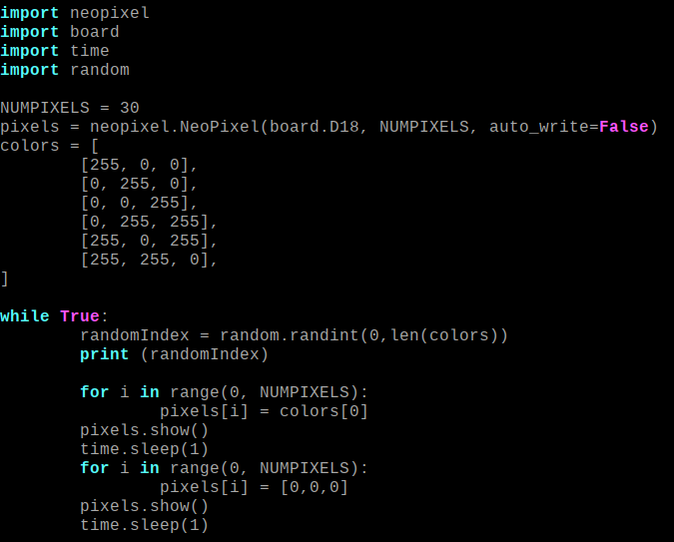
Analyzing RandomChange.py
Notes:
Let’s look at the code and try and understand what this program does. Question: Is there anything new in the import statements? Can you guess what this library does? Question: What are the colors defined in the colors array? random.randint() returns a random number between (and including) the two supplied numbers. In this case, those numbers are zero, and the length of the array called colors. Question: What are the possible values of randomIndex? Question: Can you see what the intended functionality of the code was?

Slide 5
Modifying RandomChange.py
Make changes to the code such that it cycles randomly through the values in colors instead of always showing red, and that it no longer prints values to the terminal
Ctrl+x, y, enter to save file
$ sudo python3 RandomChange.py
Notes:
Make changes to the indicated line of code to get the Chase to run in the opposite direction

Slide 6
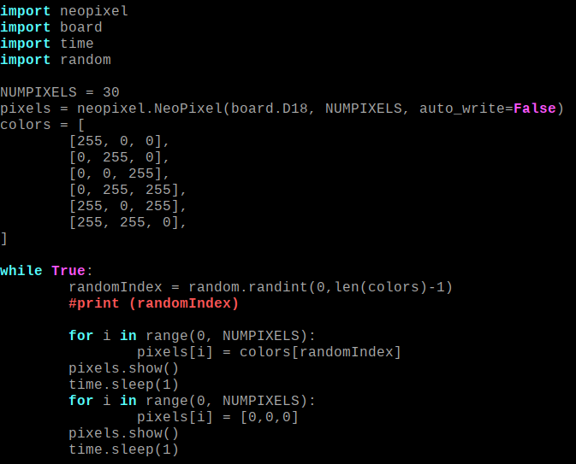
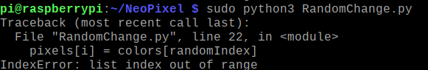
Solution RandomChange.py
myArray = [0,1,2] len(myArray) >> 3
Notes:
CLICK Instead of accessing the element at the 0th position in the index every time, we instead want to access the element at the randomIndex-th position.
CLICK We don’t want the program to continue printing this number to the terminal, so we comment it out It’s also acceptable just to delete it, but in programming and debugging it’s sometimes better to comment things out in case in case you realize you still need them. . CLICK We need to modify this line to return a random integer between zero and the length of colors minus 1. If we don’t do this, we’re likely to see the following error if we let the program run long enough. CLICK This happens if we try and get the element at len(colors), because arrays begin at zero while their lengths begin at 1. CLICK If we have an array that has three elements, it’s length is 3. But if we try to get the element at position 3, we’ll get an error, because the postions are 0, 1 and 2.

Slide 7
Working With Larger NeoPixel Strands
Notes:
The NeoPixel approach to controlling addressable LEDs offers some trade-offs compared to other, more complex approaches. On the upside, it’s very easy to wire the devices together and determine their address. On the downside, if you work with larger strands of NeoPixels, there starts to be some performance trade-offs.

Slide 8
Open Ruler.py
Open the Terminal Window and type the following commands:
$ cd ~/NeoPixel
$ nano Ruler.py

Slide 9
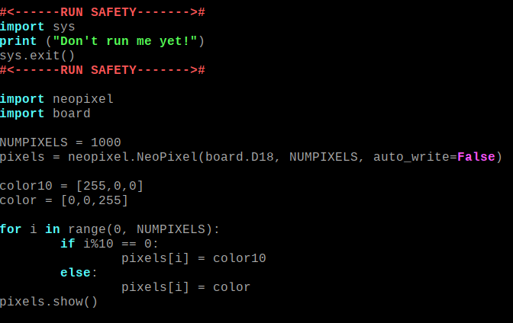
Understanding Ruler.py
Notes:
The first five lines of code are here to prevent this script from being run, you can ignore these lines since we’ll remove them later. No cheating! CLICK We’re going to go line by line through the remaining code, and see if we can determine what this program does before we run it. Question: What do the import statements do? Question: What do the next two lines define? Question: What do the next two lines define? Question: What values does our loop go over? Let me now explain the meaning of this new percent sign operator called the modulus operator CLICK

Slide 10
Deep Dive Ruler.py
The Modulus (%) Operator:
This operator is like the remainder you learned in grade school division. Most critically, it tells you if one number is evenly divisible by another; because only then does it return zero. Examples 10%10 -> 0 10%9 -> 1 5%2 -> 1 20%10 -> ? 10%20 -> ?
Notes:
This operator is like the remainder you learned in grade school division. Most critically, it tells you if one number is evenly divisible by another; because only then does it return zero. Ten goes into ten one time, no remainder, so our modulus is zero Nine goes into ten one time, with a remainder of 1, so our modulus is 1 Two goes into five two times, with a remainder of 1, so our modulus is 1 Question: What value should we expect for 20%10?
Ten goes into twenty twice, with a remainder of zero, so our modulus is 0.
20%10 -> 0 Question: What value should we expect for 10%20?
20 goes into ten zero times, with a remainder of 10, so our modulus is 10. 10%20 -> 10

Slide 11
Understanding Ruler.py
Notes:
Question: Now that we understand how the modulus operator does, can someone explain what this if else statement says? Answer: It says that if the index of the pixel is divisible by 10, we make it color10, otherwise we make it the default color. Finally, as always, we call pixels.show() to write these values to the NeoPixel strip. Question: Does his program run forever, or just once?

Slide 12
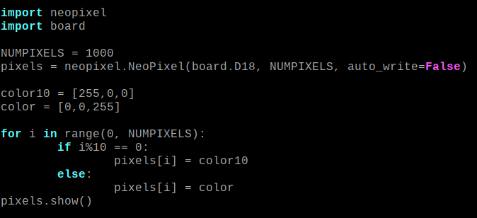
Modifying and Run Ruler.py
$ sudo python3 Ruler.py
Notes:
Delete the first block of code to make the program runnable.
Then run the program.

Slide 13
Discussing Ruler.py
Did it do what you expected it to do? Can you guess as to its purpose?
Notes:
Hint: Remember that the title of this section is: Working With Larger NeoPixel Strands. The point of the program is to help you in measuring how many pixels are in a strand, or pinpointing the pixel number of some specific pixel. You can just count the tens place quickly, and then count the ones place quickly. You could expand this program to include a hundreds place for even larger strands.

Slide 14
Understanding NeoPixel Addressing
Notes:
Here we’re going to get a little deeper into the nitty gritty of how NeoPixel strands send commands to the individual LEDs.

Slide 15
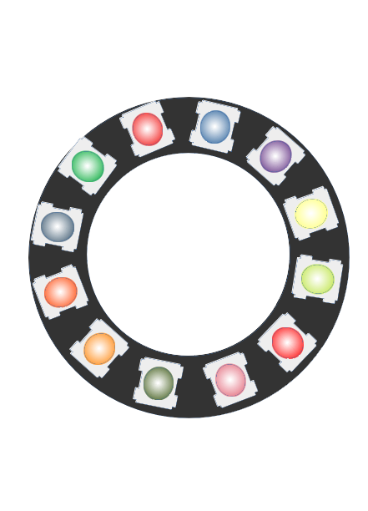
How the PWM Commands Work
🟥
🟦🟪🟨🟩🟥🟥🟩🟧🟧🟦🟩🟥
🟩🟥
🟪🟨🟩🟥🟥🟩🟧🟧🟦🟩🟥
🟦🟩🟥
🟨🟩🟥🟥🟩🟧🟧🟦🟩🟥
🟧🟦🟩🟥
🟩🟥🟥🟩🟧🟧🟦🟩🟥
🟧🟧🟦🟩🟥
🟥🟥🟩🟧🟧🟦🟩🟥
🟩🟧🟧🟦🟩🟥
🟥🟩🟧🟧🟦🟩🟥
Notes:
Lets see what happens when we send commands to the NeoPixel strand by calling pixel.show(). Here the strand is shown as a loop instead of a line, but don’t let that throw you off, it just fits better on the page. CLICK We start with an array that holds 12 colors, one for every pixel
Each color in the image represents an [r,g,b] color value. The first pixel in the chain pops the first value from the array and displays it. CLICK It sends the remaining values down to the next pixel, which displays the first color and sends on the remaining array CLICK It’s sort of like ‘take one, pass it on’ from grade school. Click x 4 This continues until there are no pixels left in the array Click x 4 If we’ve set our array size correctly, this happens when we get to the end The array always includes the value for every pixel in the array. There is no way to only send the value for one particular pixel.

Slide 16
Trade-Off Between Length and Speed
🟦🟪🟨🟩🟥🟥🟩🟧🟧🟦🟩🟥
🟦🟪🟨🟩🟥🟥🟩🟧🟧🟦🟩🟥🟦🟪🟨🟩🟥🟥🟩🟧🟧🟦🟩🟥🟦🟪🟨🟩🟥🟥🟩🟧🟧🟦🟩🟥🟦🟪🟨🟩🟥🟥🟩🟧🟧🟦🟩🟥🟦🟪🟨🟩🟥🟥🟩🟧🟧🟦🟩🟥🟦🟪🟨🟩🟥🟥🟩🟧🟧🟦🟩🟥🟦🟪🟨🟩🟥🟥🟩🟧🟧🟦🟩🟥🟦🟪🟨🟩🟥🟥🟩🟧🟧🟦🟩🟥🟦🟪🟨🟩🟥🟥🟩🟧🟧🟦🟩🟥🟦🟪🟨🟩🟥🟥🟩🟧🟧🟦🟩🟥🟦🟪🟨🟩🟥🟥🟩🟧🟧🟦🟩🟥
Notes:
The way that the pixels in a NeoPixel string are written gives us a trade off between length and speed. The longer an string of NeoPixels, the more values we need to include in the array

Slide 17
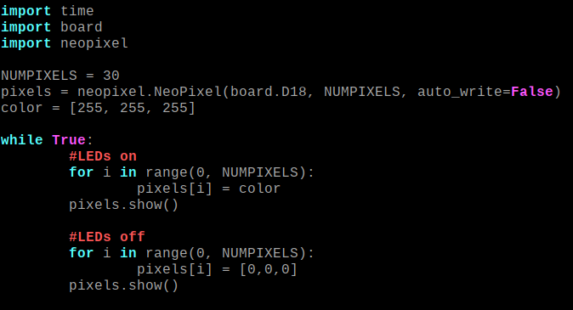
Opening Flash.py
$ cd ~/NeoPixel
$ nano Flash.py
Notes:
Question: Can anyone tell me what this program does? Note; this program does NOT contain any sleep calls. It runs as fast as it can.

Slide 18
Running Flash.py
Open the Terminal Window and type the following commands:
$ cd ~/NeoPixel
$ sudo python3 Flash.py
Notes:
Question: Did it do what you expected? Right now, it’s flashing back and forth between on and off so fast, that instead of the flashing being visible, it just looks like an LED on at about 50% of it’s normal brightness.

Slide 19
Modifying Flash.py
Change the value of NUMPIXELS from 30 to 300 and, save, and run the program again. Did it do what you expected? Change the value of NUMPIXELS from 300 to 3000, save, and run the program again. Did it do that you expected?
Notes:
We can change the definition of NUMPIXELS to change how long we are telling the neopixel library the strand is. Even though the pixels aren’t physically there, when we call pixel.show() it still creates the commands for them and sends them down the chain. Have students run changes. Question: Does anyone understand what is happening here? The longer the chain of NeoPixels in the strand, the more commands it takes to set the state of every LED We MUST ALWAYS set the state of EVERY LED. This means that the longer the chain, the slower we can refresh and change the LEDS in that chain. Because the process takes longer, we can actually see it flashing on and off.

Slide 20
Power and Voltage Considerations
Notes:
We’ve been working with a fairly short strand with modest power requirements. But if you work with larger strands, you’ll need to think about things like these.

Slide 21

Power Supply Considerations
We are limited by the current rating of our power supply, ours can do up to 3 amps. The Raspberry Pi draws about ~1A. The NeoPixel strip can draw up to 2A per meter. We are using 1 meter strips. We’re pretty much at the limit.
If you want to do a bigger strip, you’ll need a 5V power supply like the one shown here. This plugs into the wall and gives you 5V power and can be rated for various currents like 20A, 30A, and 60A depending on the model

Slide 22
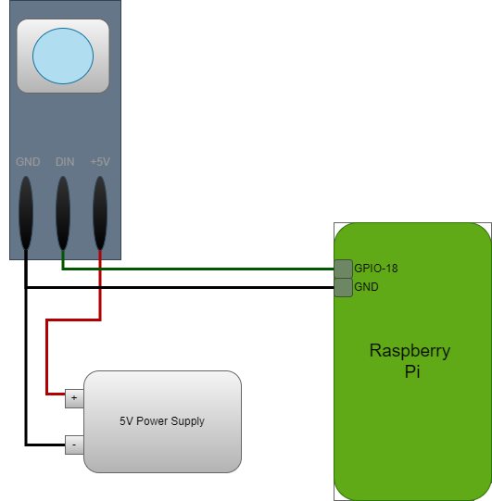
Wiring to a Power Supply
The data wire still goes to GPIO-18 on the Raspberry Pi
The +5V power wire now goes to the power supply instead of the Raspberry Pi
The GND wire now goes to BOTH the Raspberry Pi and the Power Supply.
It’s likely a logic level converter would also be used here (not pictured)

Slide 23
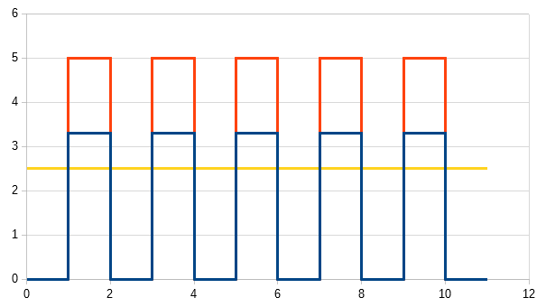
Including a Logic-Level Converter
Notes:
We’ve been cheating this entire time, using a 3.3V logic device to control a 5V logic NeoPixel. The blue chart shows the signal going up and down from a 3.3V logic source. The orange chart shows the signal going up and down from a 5V logic source, note that it’s a bit higher. The yellow plot shows the threshold level between a 1 and 0 for 5V logic. Anything over this is a 1 anything under it is a zero. 3.3V is over this source so it kind works. As this chain gets longer, this voltage can sag, and eventually it can drop down below the threshold and it will stop working. Using a logic level converter can mitigate this voltage sag issue considerably. You can see how the logic level converter is wired on the demo strip.

Slide 24
Setting up a Service to Run at Startup

Slide 25
Using Systemctl to control services
Linux systems, like the Raspberry Pi, use a program called systemctl to control services, which are programs being run automatically in the background. This can be used to make your NeoPixel program run as soon as the Raspberry Pi boots up. Building your own service is a little beyond the scope of this course, but one has been provided for you.

Slide 26
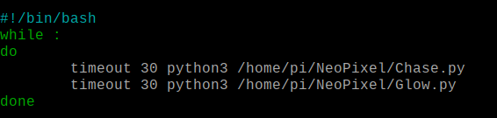
Editing Pattern.sh
$ cd ~/NeoPixel
$ sudo nano Pattern.sh
Notes:
This is a script running in a different language, called bash. We don’t go into the details, but this just runs the scripts you specify in python. The timeout command tells it how many seconds to run the script before it stops and goes onto the next element in the list. This runs Chase for 30 seconds and then runs Glow for 30 seconds. Note that we give the full path to each script /home/pi/NeoPixel/Script.py

Slide 27




Starting / Stopping the lighting service
Start the service running with the following command:
Stop the service from running with the following command:
Set the service to run at boot with the following command:
Set the service to run at boot with the following command:
Notes:
Go step by step through these commands to gain an understanding of how the services can be started and stopped on a Linux system like the Raspberry Pi. Note that if you are working on a system, you might want to disable to the service using disable instead of enable.

Slide 28
Using SSH to Control Your Pi
Notes:
One of the biggest advantages to using the Raspberry Pi for controlling NeoPixels, aside from it’s ample memory and speed, is that it has a WiFi adapter that means it can be controlled remotely. One of the biggest reasons to use a command line interface for programming, as we’ve done throughout this course, is that you can remote into your Pi and have the exact same workflow as we’ve been using here with the Pi connected to a screen and keyboard. Being able to debug and modify your code while it’s connected to whatever device you’re building, which often means a mouse and keyboard and screen or not practical, is a huge advantage.

Slide 29
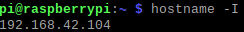
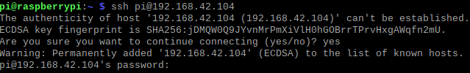
Connecting via SSH
Use the following command to get your IP address (yours will differ):
Trade IP addresses with another student. They will log into your Raspberry Pi, and you will log into theirs. Type the following command, replacing their IP address for the one shown here. When prompted, type ‘yes’ to accept the connection. The password is ‘humanmade’

Slide 30
Working via SSH
You are now connected to their Raspberry Pi, and commands will be executed on that machine. Try running one of the scripts in their NeoPixel directory and see what happens! Keep in mind, SSH does not require both machines to be a Raspberry Pi, you can connect to a Pi this way from pretty much any type of computer, as long as you are on the same network.

Slide 31
End Advanced Operations
Notes:
Thanks for taking the class! I hope you enjoyed it.

